Slide 1
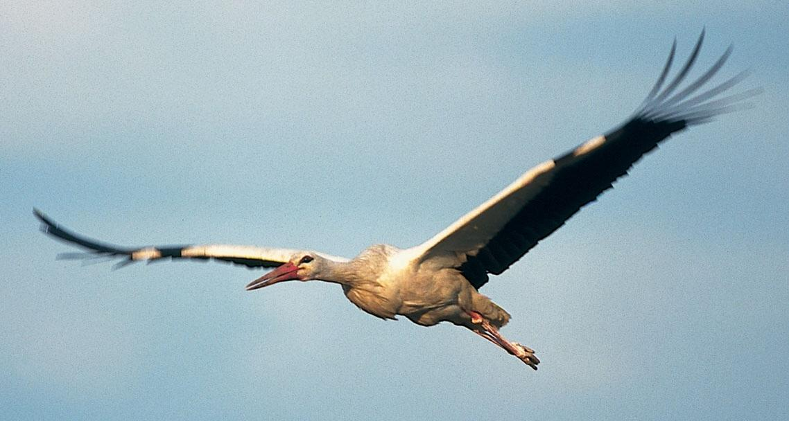


The EU‘s Agricultural Policy
Trees Robijns 6 February 2018

Slide 2
Overview of the presentation
Part I
Agriculture in the EU
Part II
Zoom: agriculture & environment
Part III
The CAP of today
Part IV
A history of reforms
Part V
The 2013 Reform in more detail
Part VI
Where do we go next?

Slide 3
PART I: Agriculture in the EU
Notes:
Data source: Eurostat: https://ec.europa.eu/agriculture/statistics/facts-and-figures_nl

Slide 4
Agriculture in the EU
The Role of Agriculture
47 % of EU’s land area, 12 million farmers
7 % of all jobs (+ food sector) generating 6 % of GDP
EU leading exporter of agricultural products
Trends
1990-2010: number of farmers halved
Productivity increased significantly (intensification & specialisation)
Average farm size growing (15 ha), but still primarily on small family holdings

Slide 5
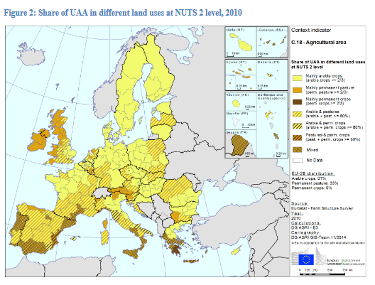
Notes:
THE LAND:
In the EU-28, the total utilised agricultural area (UAA) came to nearly 179 million ha in 2015.
•71 % of the total agricultural land is located in the EU -15 and 28% in the EU-N13.
•France has the largest agricultural area (29 million ha) covering 16% of the total UAA in Europe, followed by Spain (24 million ha), the
UK and Germany (both around 17 million ha).
•61% of the UAA was used for arable crops in 2013, 34% for permanent grassland and meadow, and 6% for permanent crops.
•More than 18.6 million hectares (10.7% of UAA) were potentially irrigable in 2013. 95% of this area is located in the EU-15, mostly in Southern Europe.
•The agricultural area irrigated at least once in 2013 in the EU-28 came to just over 10 million hectares, accounting for 5. 9% of the total UAA.

Slide 6
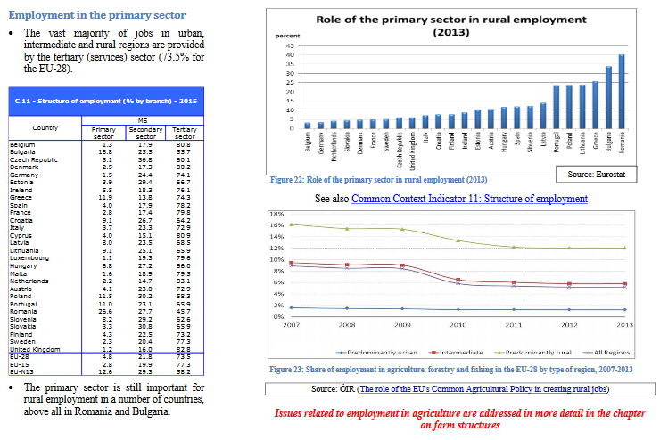
Notes:
2. THE JOBS / GDP (Value to the economy)

Slide 7
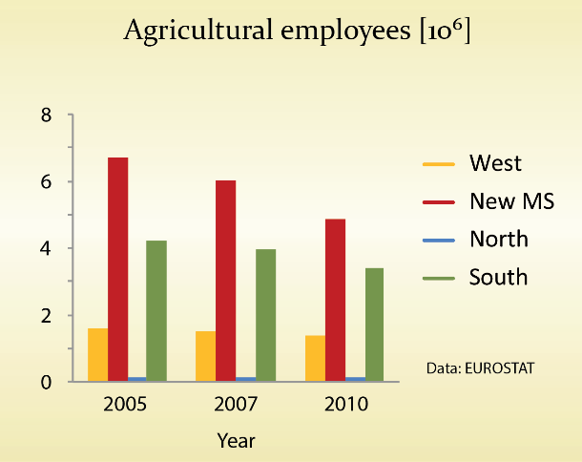
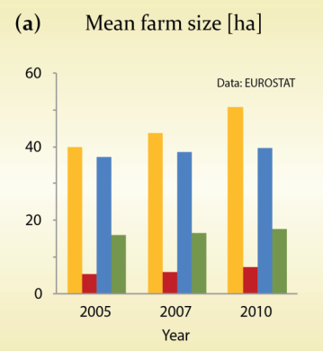
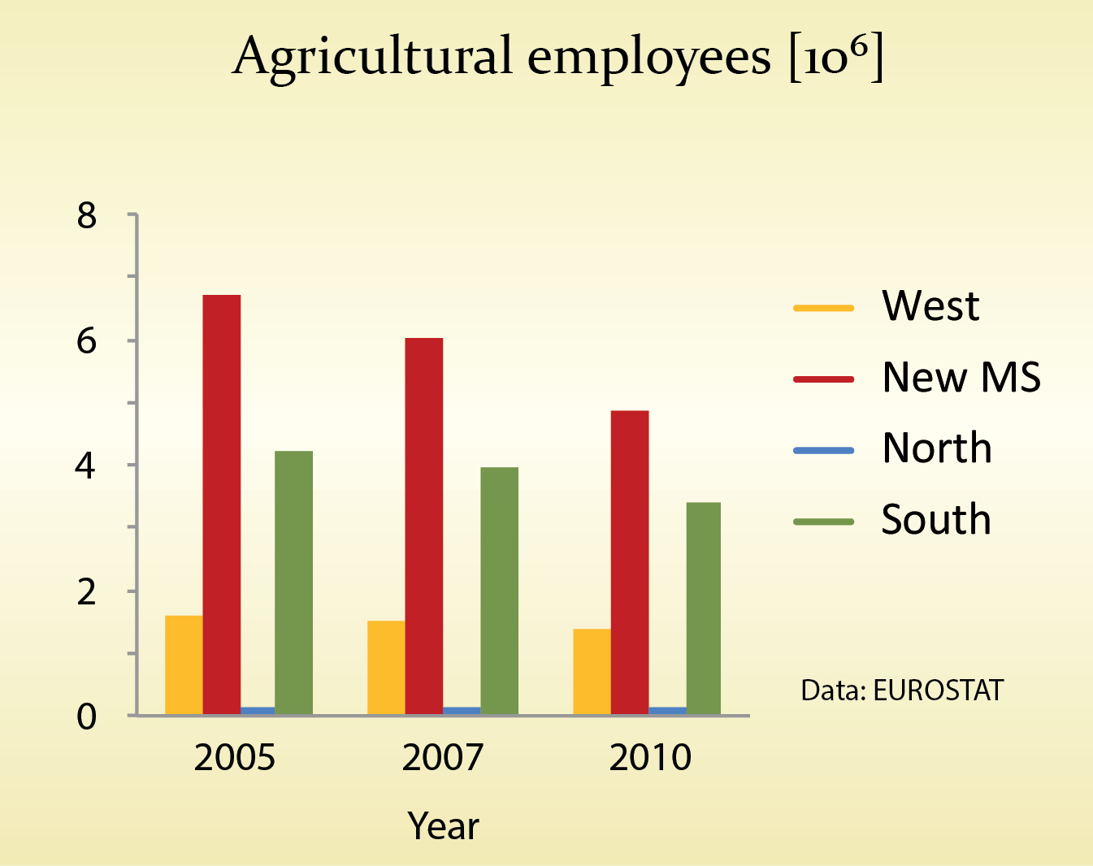
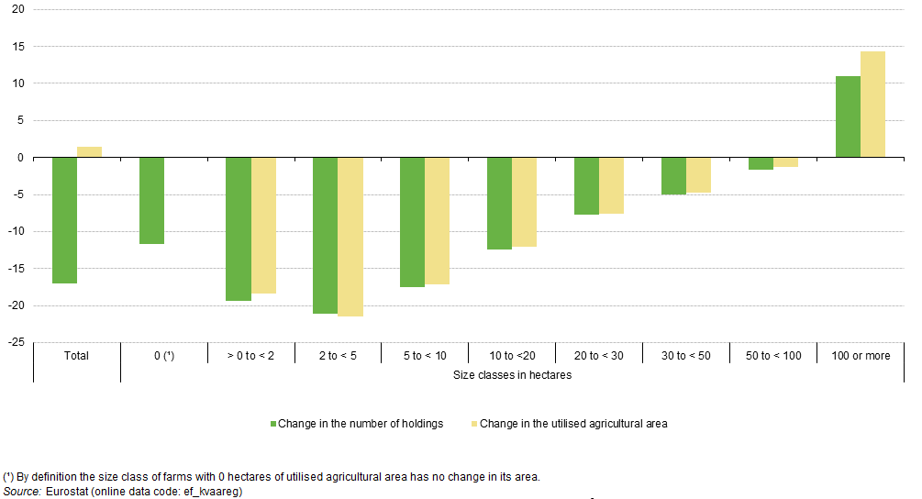
Trends: number of farms, farm employment
Decline in agriculture employees
Increase in mean Farm area
Pe’er et al. (2014): EU agricultural reform fails on biodiversity. Science 344: 1090-1092
Change in the number of holdings and utilised agricultural area by size class, EU-27, 2005–10 (%)
Decline in farm holdings (except largest farms)
Notes:
Farmer holdings declining (all except biggest farms) – total average decline of >15% in 5 year period (2005-10)
Agri employees down by over 15% everywhere (especially in new MS and Southern MS (North already very low)
Data source: EUROSTAT: http://ec.europa.eu/eurostat/statistics-explained/index.php/File:Change_in_the_number_of_holdings_and_utilised_agricultural_area_by_size_class_(utilised_agricultural_area),_EU-27,_2005%E2%80%9310_(%25).png

Slide 8
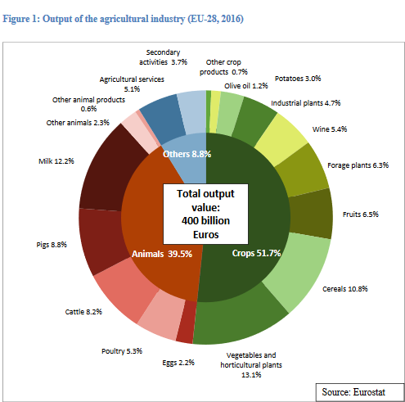
Notes:
3. PRODUCTION:
Agricultural output and input
Output composition
•In 2016, the agricultural industry of the EU-28 produced a total output value of 400billion Euros.
•Slightly more than half of this output value came from crop production (led by vegetables and horticultural plants).
•Another 39.5% came from animals and animal products.
•Agricultural services and secondary activities contributed 8.8% of total output value.

Slide 9
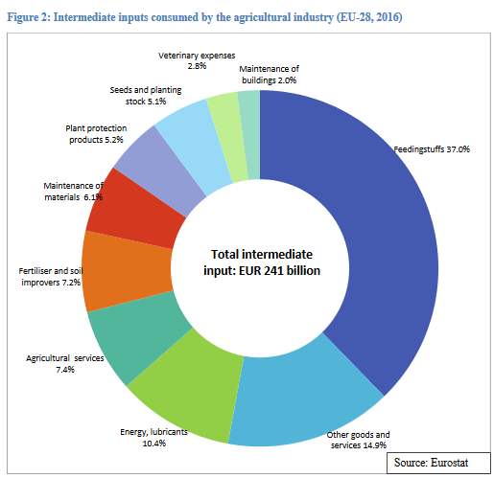
Notes:
Input composition
•Feedingstuffs for animals accounted for the highest share (37%) of total intermediate inputs, more than three times the share of energy and lubricants (10.4%).
•Fertiliser and soil improvers, plant protection products and seeds/planting stocks are inputs used exclusively for crop production. Together, they accounted for 17.5% of total intermediate inputs, less than half the value of feedingstuffs

Slide 10
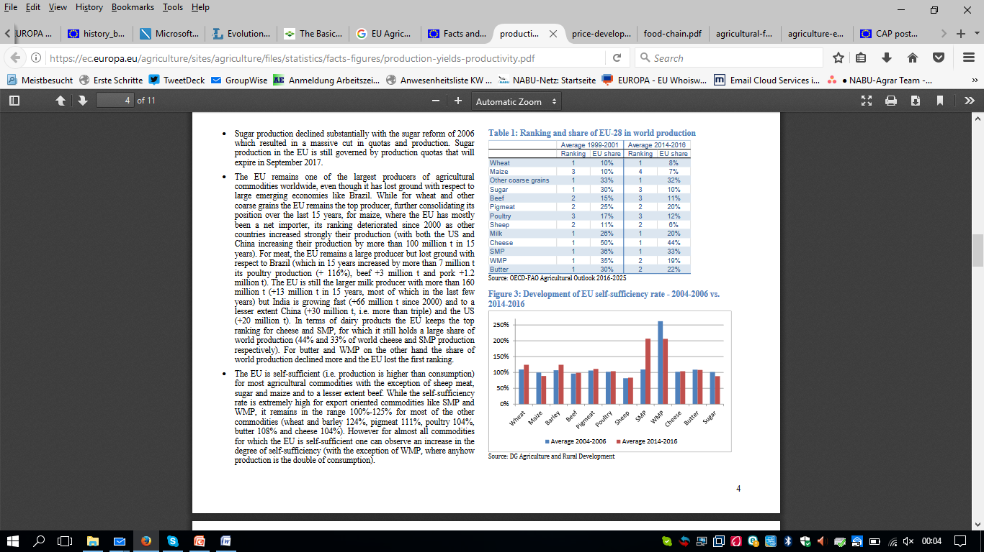
Notes:
The EU remains one of the largest producers of agricultural commodities worldwide, even though it has lost ground with respect to large emerging economies like Brazil. While for wheat and other coarse grains the EU remains the top producer, further consolidating its position over the last 15 years, for maize, where the EU has mostly been a net importer, its ranking deteriorated since 2000 as other countries increased strongly their production (with both the US and China increasing their production by more than 100 million t in 15 years).
For meat, the EU remains a large producer but lost ground with respect to Brazil (which in 15 years increased by more than 7 million t its poultry production (+ 116%), beef +3 million t and pork +1.2 million t).
The EU is still the larger milk producer with more than 160 million t (+13 million t in 15 years, most of which in the last few years) but India is growing fast (+66 million t since 2000) and to a lesser extent China (+30 million t , i.e. more than triple) and the US (+20 million t). In terms of dairy products the EU keeps the top ranking for cheese and SMP, for which it still holds a large share of world production (44% and 33% of world cheese and SMP production respectively). For butter and MP on the other hand the share of world production declined more and the EU lost the first ranking.
Self sufficiency: we are self sufficient apart from for

Slide 11
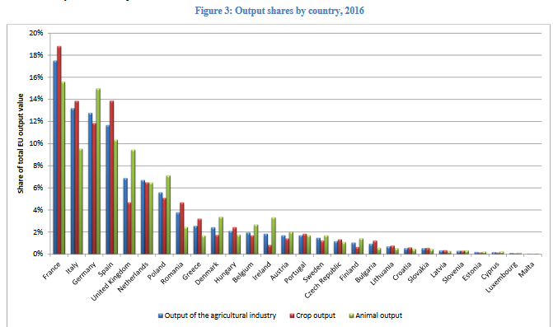
Notes:
Production value by country
•In terms of output value, France was by far the biggest agricultural producer in the EU in 2016 (17.5% of total EU output value), followed by Italy (13.2%), Germany (12.8%) and Spain (11.7%).

Slide 12
Notes:
The EU is self-sufficient (i.e. production is higher than consumption) for most agricultural commodities with the exception of sheep meat, sugar and maize and to a lesser extent beef. While the self-sufficiency rate is extremely high for export oriented commodities like SMP and WMP, it remains in the range 100% -125% for most of the other commodities (wheat and barley 124%, pigmeat 111%, poultry 104%, butter 108% and cheese 104%). However for almost all commodities for which the EU is self-sufficient one can observe an increase in the degree of self-sufficiency (with the exception of WMP, where anyhow production is the double of consumption).

Slide 13
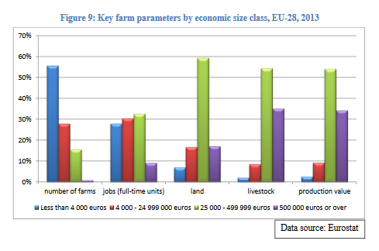
Notes:
4. FARM STRUCTURE
In terms of farm numbers , the smallest farms in economic terms (blue bar) are clearly dominant. They make up more than half of all farms in the EU. Very few farms are in the biggest economic size class (purple bar, hardly visible ).
•Most of the agricultural employment comes from farms in intermediate economic size classes (red and green bars).
•The largest share of land is managed by farms in the upper-mediumeconomic size class (green bar).
•These farms also hold most of the total livestock in the EU –but note the big share of livestock held by farms in the highest economic size class –an indication that many of the mare big livestock producers which generate a lot of output value without necessarily having much land.
•Finally, farms in the upper-medium economic sizeclass generate most of the total production value of EU agriculture.

Slide 14
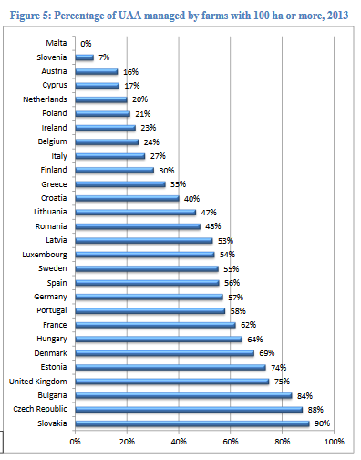
Notes:
Farm structure: Farms with more than 100ha UAA can cover a very large part of the UAA, leaving only very little land for smaller holdings, this situation is specifically problematic in… , where very big farms operate on close to all the land, while many very small farms, share the rest

Slide 15
PART II: ZOOM: Agriculture and ENVIRONMENT (Nature)

Slide 16
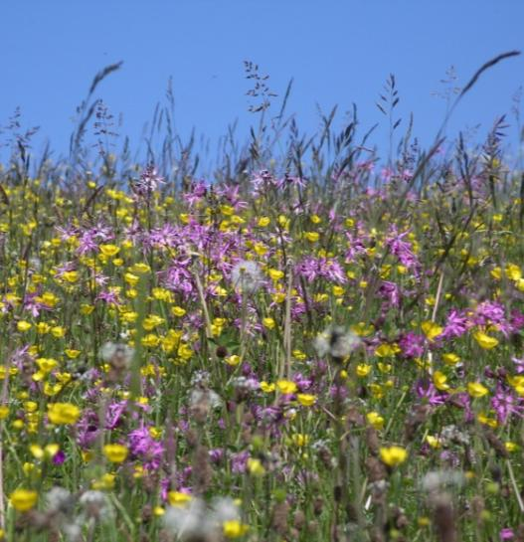
Agriculture and biodiversity
Agriculture...
has a key role in producing public goods (landscapes, farmland biodiversity, climate stability, resilience to flooding, drought and fire)
allowed many species to flourish in Europe in the last millennia
can put huge pressure on environment (soil depletion, water shortages and pollution, loss of biodiversity and landscape features)
Beate Lezius
Notes:
'Greening' the CAP is intended to slow down the decline in farmland biodiversity, its positive effects depend on implementation of specific measures by MS and farmers
Long-term food security can be established by shifting towards more ecological and resource-efficient approaches
Selecting an optimal yield target rather than maximal may outweigh any short-term productivity loss
Preservation of plant varieties and rearing of endangered breeds is crucial for the purpose of supporting a biological basis for food security
A transition towards more sustainable agro-ecosystems and increasing the resource efficiency of agriculture requires advanced agronomic skills
Protecting High Nature Value farmland (HNV) is important because of provided ecosystem services and generated public goods and the socio-economic pressures they face to intensify or abandon production
The increased competition for land (renewable energy, biofuel production etc.) is expected to influence European agriculture greatly

Slide 17
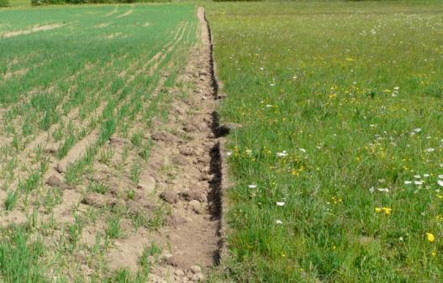
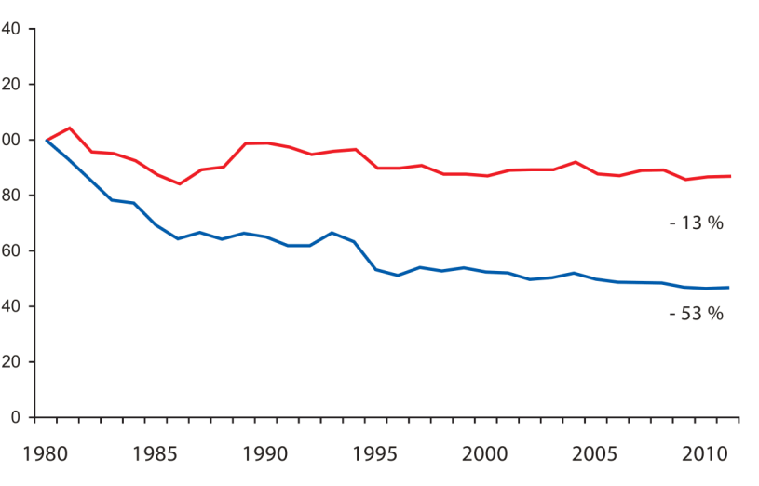
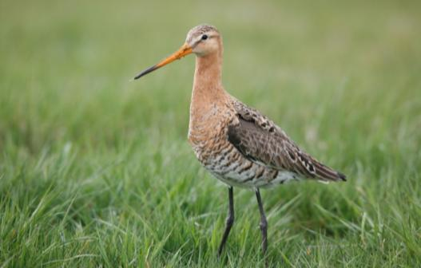
Disaster facts
EU Nature Report: Status
64 % of grassland species (non-birds) and 86 % of grassland habitats unfavourable
70 % of cropland species (non-birds) unfavourable
Trends 1980 - 2012
Grassland habitats: massive deterioration
Common farmland birds and grassland butterflies: approx. – 50 %
Black-tailed Godwit: - 37 % (DE - 75 %)
Turtle Dove – 77 % (UK – 95 %)
Skylark – 51 %
Lapwing - 60 % (DE – 75 %)
Gerd Ostermann
Beate Lezius
Common Wild Birds
Farmland Birds
Pan-European Common Bird Monitoring scheme (RSPB/EBCC/BirdLife/Statistics Netherlands)
Skylark 2008-2012; Pan-European Common Bird Monitoring scheme (RSPB/EBCC/BirdLife/Statistics Netherlands)
Frank Derer

Slide 18
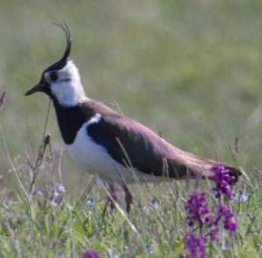
1990
(c) NABU/C. Hektor
(c) NABU/C. Hektor
(c) NABU/C. Hektor
(c) NABU/C. Hektor
(c) NABU/C. Hektor
(c) NABU/C. Hektor
(c) NABU/C. Hektor
(c) NABU/C. Hektor
(c) NABU/C. Hektor
(c) NABU/C. Hektor
(c) NABU/C. Hektor
(c) NABU/C. Hektor
(c) NABU/C. Hektor

Slide 19
2015
(c) NABU/C. Hektor
(c) NABU/C. Hektor
(c) NABU/C. Hektor
(c) NABU/C. Hektor
Lapwing: - 75 %

Slide 20
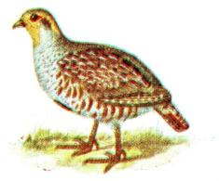
1990
(c) Rapphöna, Iduns kokbok Wikimedia Commons
(c) Rapphöna, Iduns kokbok Wikimedia Commons
(c) Rapphöna, Iduns kokbok Wikimedia Commons
(c) Rapphöna, Iduns kokbok Wikimedia Commons
(c) Rapphöna, Iduns kokbok Wikimedia Commons
(c) Rapphöna, Iduns kokbok Wikimedia Commons
(c) NABU/C. Hektor
(c) Rapphöna, Iduns kokbok Wikimedia Commons
(c) Rapphöna, Iduns kokbok Wikimedia Commons
(c) Rapphöna, Iduns kokbok Wikimedia Commons
(c) Rapphöna, Iduns kokbok Wikimedia Commons
(c) Rapphöna, Iduns kokbok Wikimedia Commons
(c) Rapphöna, Iduns kokbok Wikimedia Commons
(c) Rapphöna, Iduns kokbok Wikimedia Commons
(c) Rapphöna, Iduns kokbok Wikimedia Commons
(c) Rapphöna, Iduns kokbok Wikimedia Commons
(c) Rapphöna, Iduns kokbok Wikimedia Commons
(c) Rapphöna, Iduns kokbok Wikimedia Commons
(c) Rapphöna, Iduns kokbok Wikimedia Commons

Slide 21
2015
(c) NABU/C. Hektor
(c) Rapphöna, Iduns kokbok Wikimedia Commons
Partridge: - 94 %

Slide 22
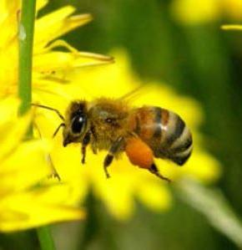
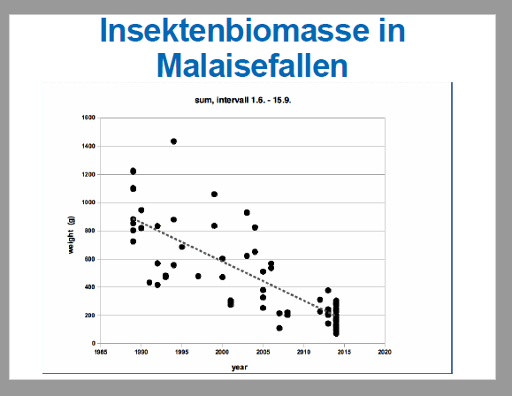
The insect crisis
EU Red List of Bees
9.1 % of species threatened with extinction (30 % of these endemic to Europe)
Trends for 80 % of species unknown
Local studies Western Germany
Locally now around 60 % of bumblebees and butterfly species extinct
Biomass of flying insects declined by 70-80 % in 25 years
A major ecological disaster seems to be underway, and agriculture is in the middle of it!
Frank Derer
Thorsten Krüger
BirdLife Europe

Slide 23
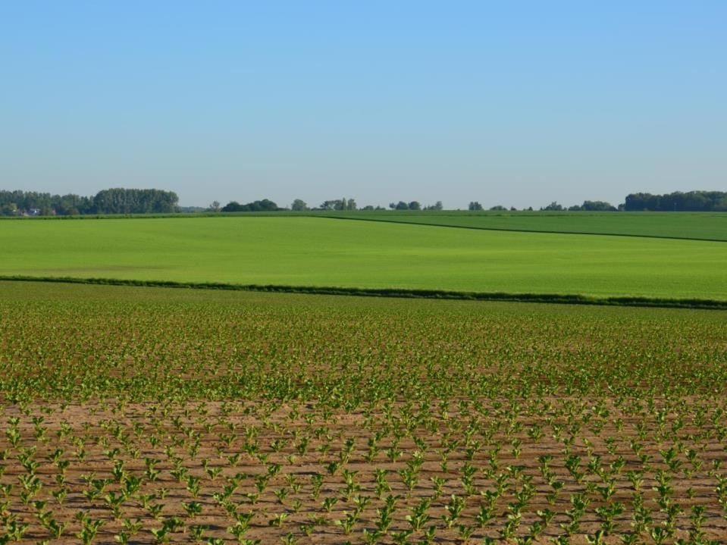
We know the causes of the crisis
Removal of diversification elements
Conversion of semi-natural habitats
More and more winter cereals
Increase of insecticides/herbicides
Ploughing permanent pastures
Mechanisation
Less nesting habitat
Nest destruction
Increased vulnerability to predators
Less feed available
Notes:
The EU’s 2015 State of Nature Report tells us that the number one reason for the decline of biodiversity in the EU is agriculture.
Put simply, it is either intensification or abandonment of sustainable farming systems that leads to a lack of food and habitat for many birds.

Slide 24
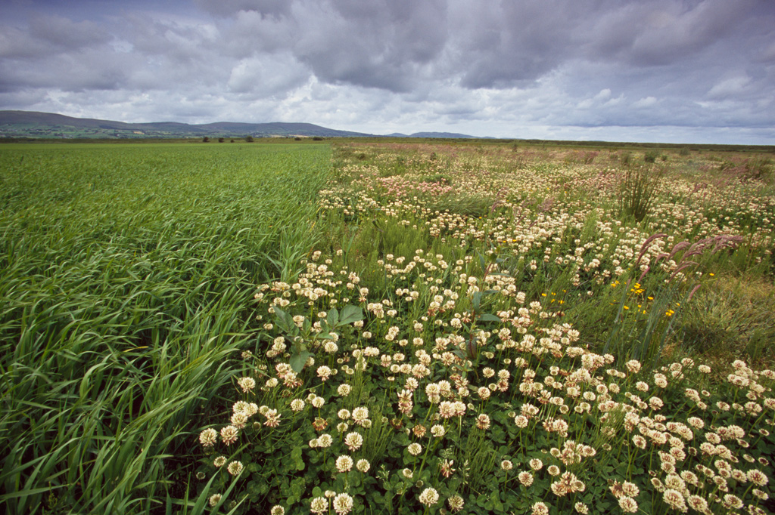
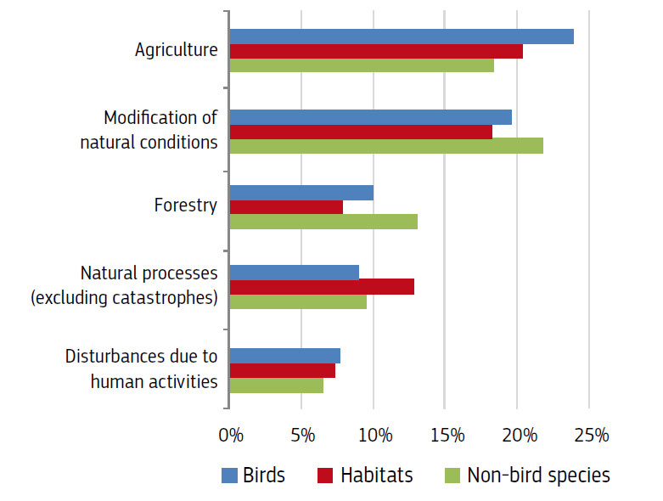
EU State of Nature Report 2015 based on Member State info
Reasons for biodiversity loss
European Commission (2015): The State of Nature in the EU, p.32
Notes:
The State of Nature Report tells us what governments have identified as biggest threats to biodiversity.
The number one reason for the decline of biodiversity in the EU is agriculture. Put simply, it is either intensification or abandonment of sustainable farming systems that leads to a lack of food and habitat for many birds.
The second biggest threat is related to habitat changes due to modifications of the water regime or to a decreased connectivity among habitats, followed by forestry.

Slide 25
PART III: The cap of today

Slide 26
The current structure: 2 pillars, 4 regulations, 2 funds
European Agricultural Guarantee Fund (EAGF) – also includes promotion and school fruit scheme, etc.
European Agricultural Fund for Rural Development (EAFRD)
Pillar 1:
Annual direct payments to “active” farmers (mandatory greening, young farmers, etc.(Direct Payment Regulation (EU) No 1307/2013 )
Market measures Regulation (EU) No 1308/2013
Pillar 2:
Multi-annual rural development schemes programmed by Member States/regions based on 6 priorities Regulation (EU) No 1305/2013
Financing and monitoring (horizontal Regulation (EU) No 1306/2013): rules for CAP expenditure, farm advisory system, control systems and cross-compliance
Notes:
direct payments linked to environmental-friendly practices (Regulation (EU) No 1307/2013) a set of common rules for Direct payments for active farmers including a mandatory "greening" component and a focus on young farmers; all payments are subject to cross-compliance. European Union (EU) countries can grant payments to farmers in areas with natural constraints on a voluntary basis or opt for a simplified scheme for small farms. More on direct support
market measures (Regulation (EU) No 1308/2013): basic elements for a common organisation of markets in agricultural products, such as private storage aid for certain products listed in the regulation, etc.
rural development (Regulation (EU) No 1305/2013): fosters the development of rural areas in terms of competitiveness, sustainable management of natural resources and job creation. It outlines priorities such as the transfer of knowledge and innovation, the promotion of food chain organisations in sectors such as fruits and vegetables, energy or water efficiency in agriculture and food processing, etc. EU countries can align rural development programmes to best respond to country-specific needs
horizontal issues (Regulation (EU) No 1306/2013: lays down the rules for CAP expenditure, the farm advisory system, control systems set up by EU countries and the cross-compliance system

Slide 27
Pillar 1: measures
basic payment (#/ha)
a ‘green’ direct payment for agricultural practices beneficial for the climate and the environment,
a payment to young farmers,
(where applied) a redistributive payment to provide improved support to small and middle-size farms,
(where applied) payments for areas with natural constraints,
(where applied) a small farmers scheme,
and (where applied) voluntary Support coupled to production
Notes:
Direct payments are granted to farmers in the form of a basic income support based on the number of hectares farmed. This so-called ‘basic
payment’ is complemented by a series of other support schemes targeting specific objectives or types of farmers:
a ‘green’ direct payment for agricultural practices beneficial for the
climate and the environment,
a payment to young farmers,
(where applied) a redistributive payment to provide improved
support to small and middle-size farms,
(where applied) payments for areas with natural constraints, where
farming conditions are particularly difficult, such as mountain
areas,
•
(where applied) a small farmers scheme, a simplified scheme for
small farmers replacing the other schemes,
•
and (where applied) voluntary
S
upport coupled to production to
help certain sectors undergoing difficulties.
https://ec.europa.eu/agriculture/sites/agriculture/files/direct-support/direct-payments/docs/direct-payments-schemes_en.pdf

Slide 28
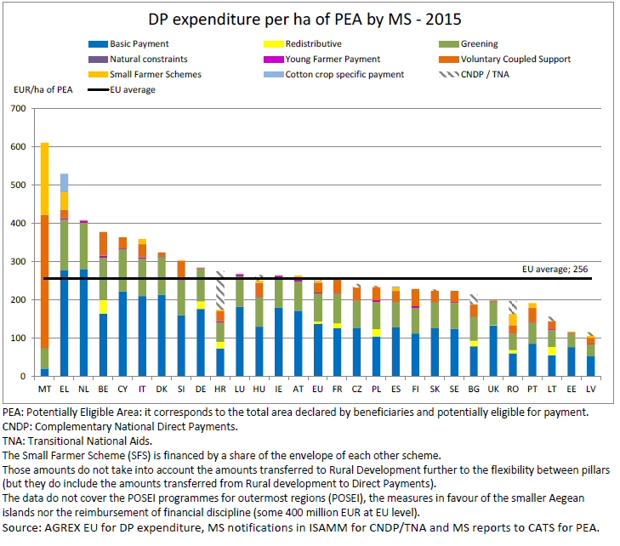
Notes:
On average, the payment is €266 per hectare eligible for payment
there were around 7 million farms benefitting from support in 2015, covering almost 156 million ha of land,
or roughly 90% of the land actually farmed
http://capreform.eu/how-member-states-are-implementing-the-new-cap/

Slide 29
Pillar 2: measures
118 Rural Development Programmes
Over 20 different measures
Investments, Risk management, Farm and business development
Agri/Forest-environment-climate, organic farming, animal welfare, Natura 2000 and Water Framework Directive
Areas of Natural Constraints
Leader, Cooperation
Basic services and village renewal
Knowledge transfer, Advisory services
Technical assistance
Producer Groups, quality schemes

Slide 30
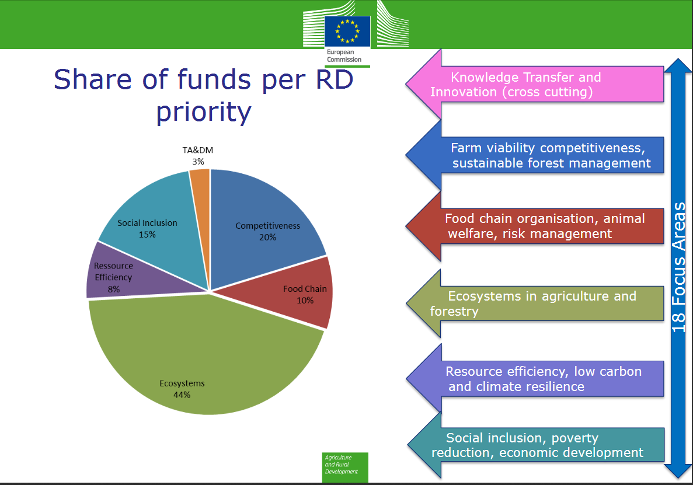
Notes:
https://ec.europa.eu/agriculture/sites/agriculture/files/rural-development-2014-2020/country-files/common/rdp-list_en.pdf

Slide 31
The figures: 2014-2020 programming period
The CAP 2014-2020 accounts for 38 % of the EU budget. Under the 2014-2020 Multiannual Financial Framework, a total of 408.31 billion Euro is earmarked for the CAP.
This falls under Heading 2: Preservation and management of natural resources - apart from the CAP, it also includes the common fisheries policy, and environmental measures.
The largest part (Euro 308.72 billion) is allocated to the first pillar (of which 293 billion for direct payments), whereas the remaining Euro 99.6 billion is allocated to the second pillar (which is topped up to Euro 161 billion with other public money).

Slide 32
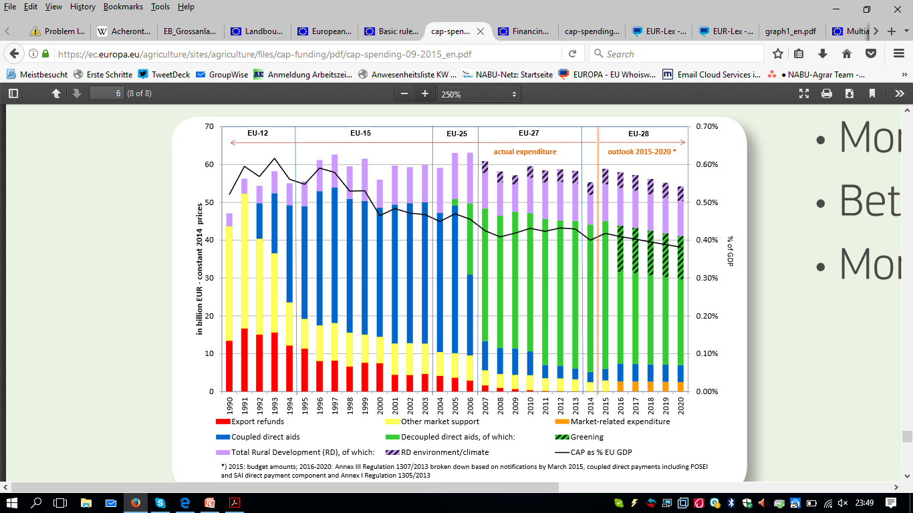
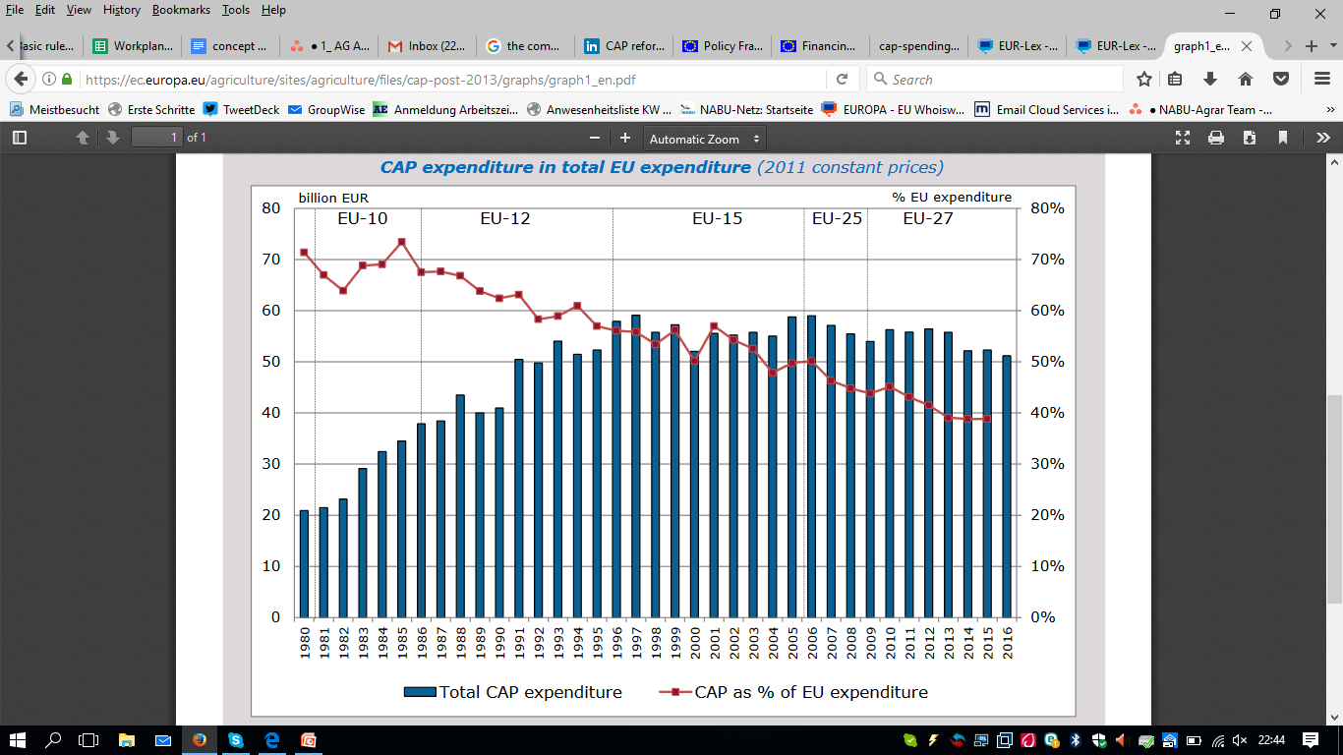
It was once quite a different story …
Notes:
Graph 1: https://ec.europa.eu/agriculture/sites/agriculture/files/cap-post-2013/graphs/graph1_en.pdf
Graph 2: https://ec.europa.eu/agriculture/sites/agriculture/files/cap-funding/pdf/cap-spending-09-2015_en.pdf

Slide 33
PART IV: A history of reforms

Slide 34
The CAP: its origin
Western European countries coming out of the war
Six countries create the EEC (forerunner of the EU) in 1957
agriculture included as part of the common market
Handing over real power to the community level
CAP objectives enshrined in the Treaty of Rome (art 39)
To increase agricultural productivity by promoting technical progress and by ensuring the rational development of agricultural Production and the optimum utilization of the factors of production, in particular labor;
thus to ensure a fair standard of living for the agricultural community in particular by increasing the individual earnings of persons engaged in agriculture;
to stabilize markets;
to ensure the availability of supplies;
to ensure that supplies reach consumers at reasonable prices.
Notes:
Agriculture had been crippled and food supplies could not be guaranteed
Food rationing was still a fact in several countries even in the 1950-ies
They had tried to get a debate going which also included the UK, but the internal market clashed with the need to continue trading with the commonwealth and the talks fell in the water
France was a big farm country and would only open its borders to German industrial products, if Germany opened its borders for French food

Slide 35
The CAP: its creation (1962)
Principles
a. Free intra-community trade;
b. Community preference;
c. common financing
The start of:
common market organisations for 6 agri products,
competition rules,
a schedule to assist intra-community trade for dairy products, beef and veal was introduced,
establishment of the European Agricultural Guidance and Guarantee Fund
Notes:
a. Free intra-community trade: no barriers to trade in agricultural products between the member states;
b. Community preference: suppliers f rom within the Community were to be given preference in the market over those from outside the Community;
c. common financing: funding for the CAP would be through a European budget for all revenues and expenditures generated by the policy
The start of:
common market organisations for 6 agri products (cereals, pig meat, eggs, poultry meat, fruit and vegetables and wine),
competition rules were introduced,
a schedule to assist intra-community trade for dairy products, beef and veal was introduced,
establishment of the European Agricultural Guidance and Guarantee Fund (EAGGF)

Slide 36
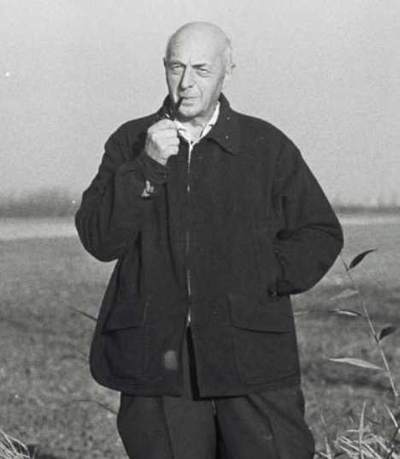
Mansholt: policy entrepreneur and farmer
“Only” 3 new directives in 1972
concerned the modernisation of agricultural holdings,
the abandonment of farming
the training of farmers
Notes:
Sicco Mansholt, a Dutch farmer and politician, was the main architect of Europe's farm policy
first a big plan to modernise farming – big restructuring
=> 1968: Wake up call about surpluses and the need for restructuring in agriculture
1980 Agricultural Programme >> first time idea to take land out of production for economic reasons, over production, farmers‘ income had not gone up enough, encourage 5 million farmers to stop farming (still with 6M)
and environmental problems

Slide 37
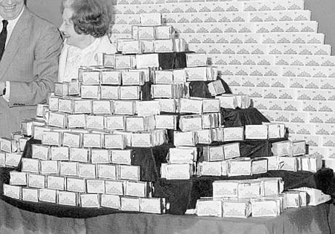
The 80-ies: food mountains
-move towards self sufficiency
-permanent surpluses
-exported, with the help of subsidies, (expensive, market distortions,
-stored
-disposed within the EU.
-1984: milk quotas (sugar quotas already existed)
-1988: max ceiling CAP budget + limit
quantities guaranteed for support
Notes:
-move towards self sufficiency
-permanent surpluses
-exported, with the help of subsidies,
-stored
-disposed within the EU.
-high budgetary cost,
-distorted some world markets,
did not always serve the best interests of farmers and became unpopular with consumers and taxpayers. In 1984 the EU introduced milk quotas, extending the production quota system already applied to sugar. In 1988, a maximum ceiling for the CAP budget was introduced. A limit on the quantities guaranteed to receive support payments was also set.

Slide 38
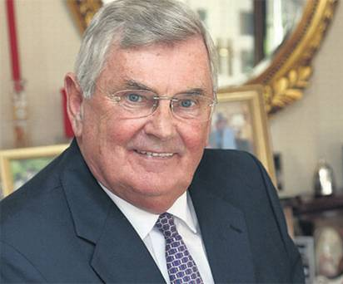
The 1992 Reform - MacSharry
WTO – Uruguay round as one of the key drivers
shift from product support (through prices) to producer support (through income support, direct payments)
Creation of set aside
Limit stocking levels
Encourage retirment and afforestation
Notes:
In 1992, the MacSharry reforms (named after the European Commissioner for Agriculture, Ray MacSharry) were created to limit rising production, while at the same time adjusting to the trend toward a more free agricultural market. The reforms reduced levels of support by 29% for cereals and 16% for beef. They also created 'set-aside' payments to withdraw land from production, payments to limit stocking levels, and introduced measures to encourage retirement and afforestation.
Since the MacSharry reforms, cereal prices have been closer to the equilibrium level, there is greater transparency in costs of agricultural support and the 'decoupling' of income support from production support has begun. However, the administrative complexity involved invites fraud, and the associated problems of the CAP are far from being corrected.^{[citation needed]}
One of the factors behind the 1992 reforms was the need to reach agreement with the EU's external trade partners at the Uruguay Round of the General Agreement on Tariffs and Trade (GATT) talks with regards to agricultural subsidies.^{[9]}

Slide 39
Agenda 2000
-established economic, social, and environmental goals within the objectives of the CAP
-small further reduction in market distortions
-start of the rural development policy
>> Already under the leadership of Franz Fischler
Notes:
the Commission's Agenda 2000, adopted in 1999, established economic, social, and environmental goals within the objectives of the CAP,
The Agenda 2000 reforms made a small further reduction in market distortions and introduced an environmental focus.
They encouraged single EU countries to adopt a comprehensive rural development policy, which built on earlier reforms, and further reductions in intervention prices, which were compensated for by direct payments

Slide 40
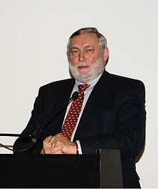
The 2003 Reform – Fischler Reform
Another policy entrepreneur – using the Iraq war to get one of the most radical reforms of the CAP:
-decoupling: consolidated shift to income support by the introduction of a single payment scheme
-introduction of the 'cross compliance' concept
-modulation between pillars
Notes:
-consolidated shift to income support by the introduction of a single payment scheme not linked to production of any particular product ('decoupled') and introduced the 'cross compliance' concept, linking payments to respect of food safety, environmental protection and animal health and welfare standards
The perfect storm

Slide 41
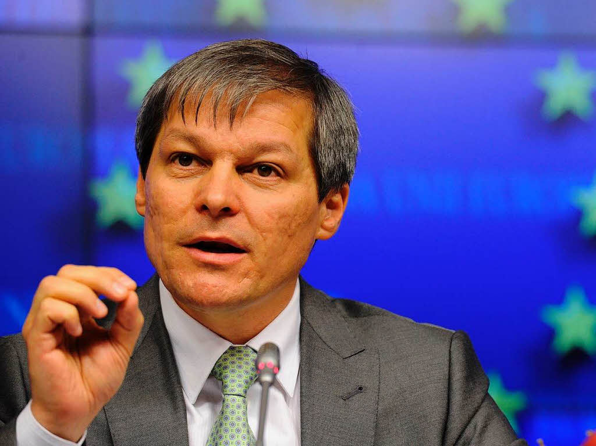
The 2013 Reform: The Ciolos reform
public money for public goods
introduction of greening
producer support
small farmers

Slide 42
Part v: the last reform in more detail

Slide 43
The premise of last CAP reform
The debate for 2014-2020
Real pressure on the EU budget – Budget and Agri debate at same time
Public money for public goods
Context: EU Biodiversity Strategy
Target 3: “Maximise areas under agriculture across grasslands, arable land and permanent crops that are covered by biodiversity-related measures under the CAP”
first time Co-Decision with 28 Member States
Food security as a major driver of the public debate
Notes:
Target 3 - A) Agriculture: By 2020, maximise areas under agriculture across grasslands, arable land and permanent crops that are covered by biodiversity-related measures under the CAP so as to ensure the conservation of biodiversity and to bring about a measurable improvement(*) in the conservation status of species and habitats that depend on or are affected by agriculture and in the provision of ecosystem services as compared to the EU2010 Baseline, thus contributing to enhance sustainable management.
Action 8: Enhance direct payments for environmental public goods in the EU Common Agricultural Policy
8a) The Commission will propose that CAP direct payments will reward the delivery of environmental public goods that go beyond cross-compliance (e.g. permanent pasture, green cover, crop rotation, ecological set-aside, Natura 2000).
8b) The Commission will propose to improve and simplify the GAEC (Good Agricultural and Environmental Conditions) cross-compliance standards and consider including the Water Framework Directive within the scope of cross-compliance once the Directive has been implemented and the operational obligations for farmers have been identified in order to improve the state of aquatic ecosystems in rural areas.
Action 9: Better target Rural Development to biodiversity conservation
9a) The Commission and Member States will integrate quantified biodiversity targets into Rural Development strategies and programmes, tailoring action to regional and local needs.
9b) The Commission and Member States will establish mechanisms to facilitate collaboration among farmers and foresters to achieve continuity of landscape features, protection of genetic resources and other cooperation mechanisms to protect biodiversity.

Slide 44
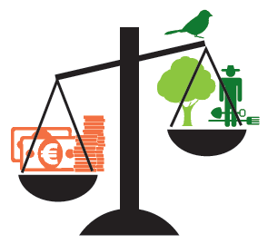
The CAP reality
The money - progressive part of CAP goes down
Rural development budget has been slashed by 13.4 % compared to previous period
5 countries (HR, MT, PL, SK, HU) will transfer around 3 billion Euro from second to first pillar
Notes:
RD budget has been slashed by 13,4 % compared to MFF 2007-2013 (DP only by 8,8%)
5 countries (HR, MT, PL, SK, HU) used reverse modulation and will transfer around 3 billion EUR from 2nd to 1st pillar until 2020
MFF 2007-2013 :
DP: 304,831 EUR millions
RD: 98,140 EUR millions
MFF 2014-2020 (EUCO 08/02/2013)
277,851 EUR millions
RD:84, 936 EUR millions
Modulation and reverse modulation:
DP to RD total 11 countries: MEUR 6.382,6 until 2020
RD to DP total 5 countries: MEUR 3.358,2 until 2020
Net from pillar 1 to pillar 2: 3 billion over next 6 years.

Slide 45
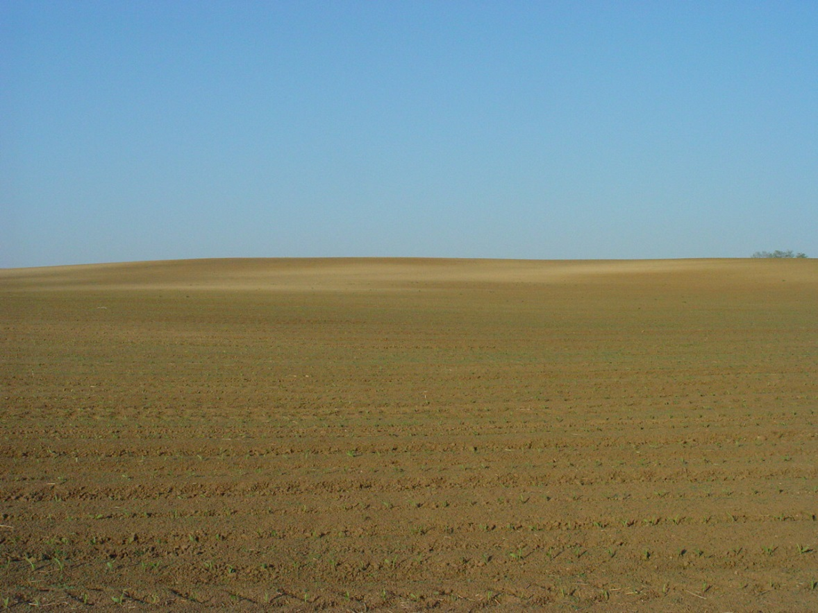
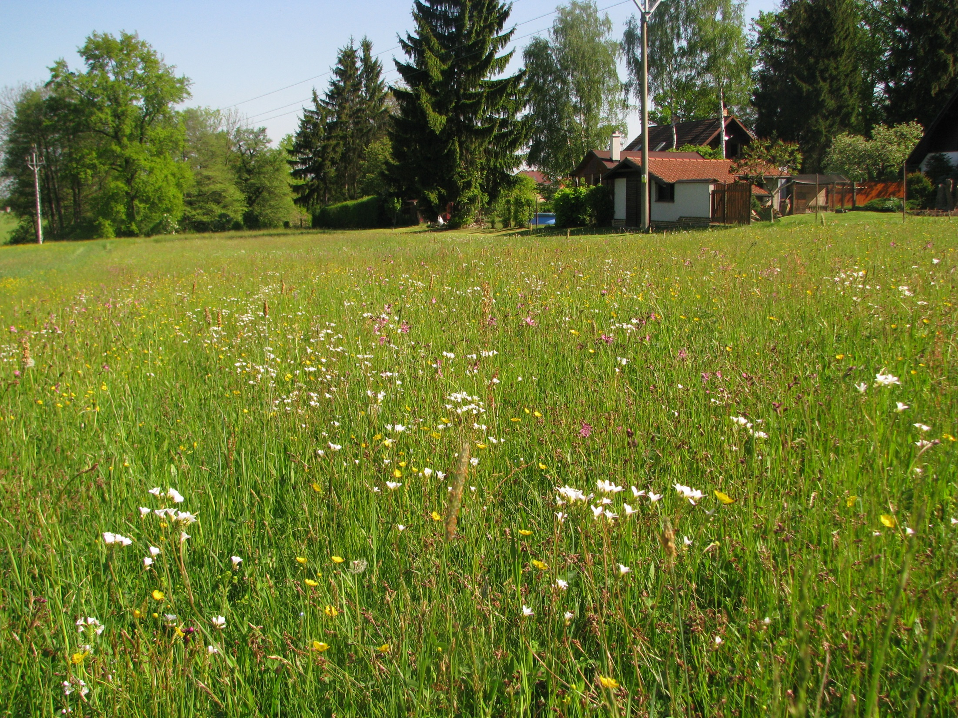
CAP Greening
Lifting the baseline with greening?
Ecological Focus Area - an empty shell?
N fixing crops vs landscape elements
Use of pesticides is allowed
Permanent grassland – avoid destruction?
Only 8 MS designated all grasslands
6 MS designated < 1/2 grasslands
Crop diversification – stop monoculture?
1/4 of arable land exempted
Monoculture deemed green (FR)
Nagy
Notes:
Ecological Focus Area - an empty shell
27 MS have nitrogen fixing crops in EFA
Use of pesticides not banned
N fixing crops are a great practice as part of crop rotation but having 5% of your farm in a soy field in stead of having buffer strips and hedge rows is completely meaningless
Creative accounting

Slide 46

Rural Development
Good intentions & numbers
MS were asked to maintain the 2007-2013 level of efforts + spend 30% on environment & climate measures
MS were asked to increase targeting in AEM (ECA)
Agri-environment: 16.8 % of total public expenditure
Total agricultural land under contracts supporting biodiversity and/or landscapes: 19 %
Notes:
Technical elements of agri-environment-climate measure in the programming period 2014 – 2020:
p.6 …However, as the ECA has noted, targeting of AECMs is an important tool for delivering environmental benefits efficiently – and efficient delivery is becoming more important as pressure on funding increases…
The ECA also found that in the period 2007 – 2013 MS had not considered the desirable degree of targeting for their needs.
Therefore, for the post-2013 period MS / regions will need to see how they can make greater use of targeting – overcoming any practical challenges of implementing and administering more targeted AECMs.
Request to spend similar amount: (recital 22 of EAFRD)
Total agricultural land under contracts supporting biodiversity :
More than 70%: AT, MT, EE
More than 20%: PT, SI, UK, CZ, SK
More than 10%: IE, IT, ES, DE, FI, PL, HU, LV, FR, BG, DK, LT
Less than 10%: RO, BE, HR, NL
Based on commission figures presented in last Civil Dialogue Group on Rural Development

Slide 47
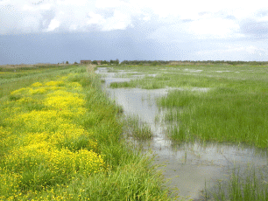
Rural Development
Too often sad reality
AEM budgets reduced and targeted biodiversity schemes missing or underfunded (e.g. FI, PL, SI, SK, DE, ...)
Decades of conservation work at risk of being lost (e.g. Emilia Romagna - IT)
Money going to arable farming where grassland is the problem (e.g. LV, ES, …)
Positive exceptions exist (e.g. AU) – increased budget for targeted, good AEM

Slide 48
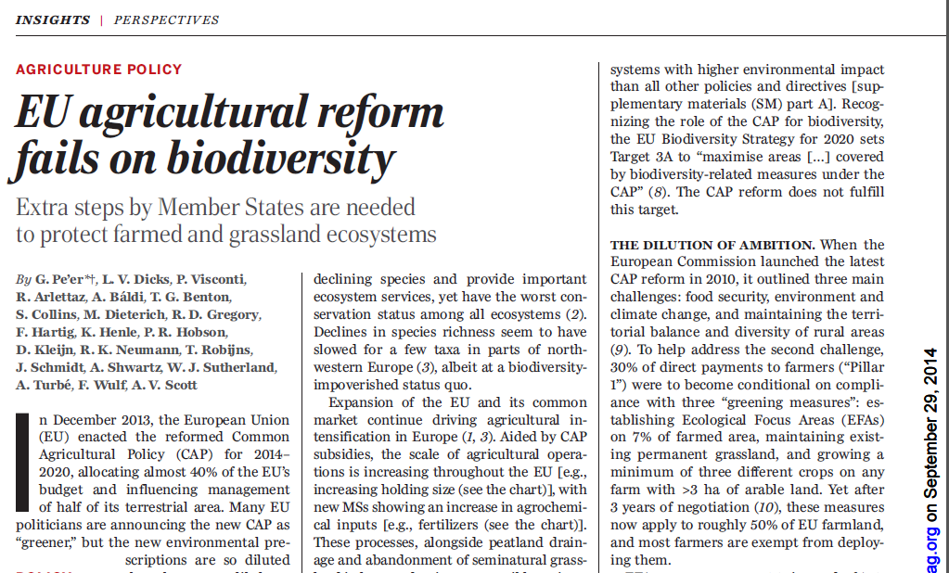
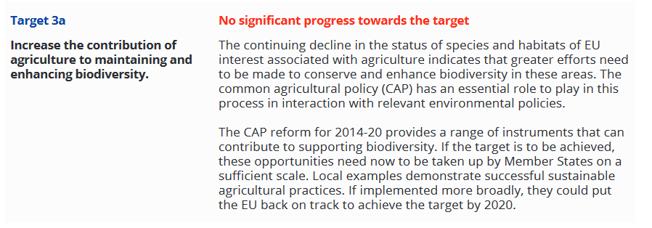
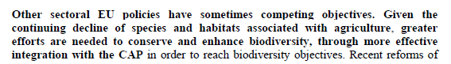
The reality of the premise

Slide 49
‘Green(wash)ing’ Direct Payments
MS choose least ambitious options
Weakening of CC
Reverse modulation
Move from ‘dark green’

Slide 50
pArt vi: where do we go next?

Slide 51
The CAP reform post 2020
Where do we stand
Commission’s impact assessment: February 2017
Commission’s public consultation: May 2017
Commission’s Communication: November 2017
Commission’s Communication on MFF expected: May 2018
Commission’s legislative proposals on the CAP: May/June 2018
EP: Group positioning, Report on MFF ongoing
Council: debate started under Maltese Presidency 2017
Stakeholders: positioning ongoing
Brexit: UK scheduled to leave EU: 29 March 2019
Election EP: May 2019 and appointment new Commission

Slide 52


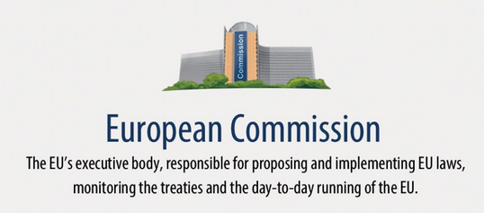
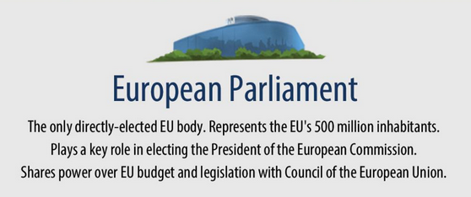

Influencing the EU
Preliminary ruling
Consultation, Complaint, ECI..
Exchange MEPs
Exchange MS
Source: europarl.europa.eu

Slide 53
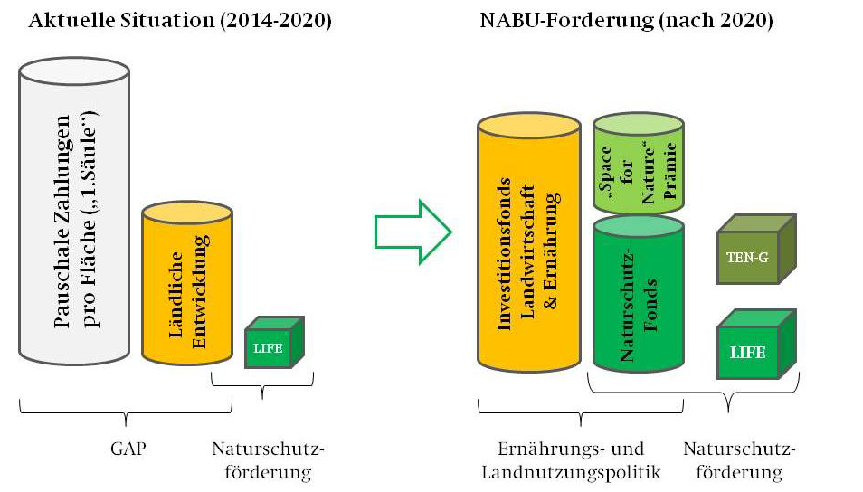
The NGO way forward
The BirdLife (and EEB) proposal
Transition instrument for sustainable farming: temporary, finance switch to high-quality, nature-/animal-friendly and profitable economic model, invest in healthy, economically diverse rural areas.
Sustainable Food instrument: investments to build up sustainable value chains, reduce food waste and increase the demand for healthy and environmentally sound food at fair prices.
Nature and Biodiversity instrument: the central EU fund for financing about 75 % of the costs of implementation of the EU nature legislation (Natura 2000).
Space for Nature instrument: an area-based entry level payment scheme for strictly non-productive elements.

Slide 54


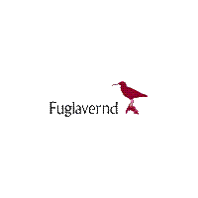
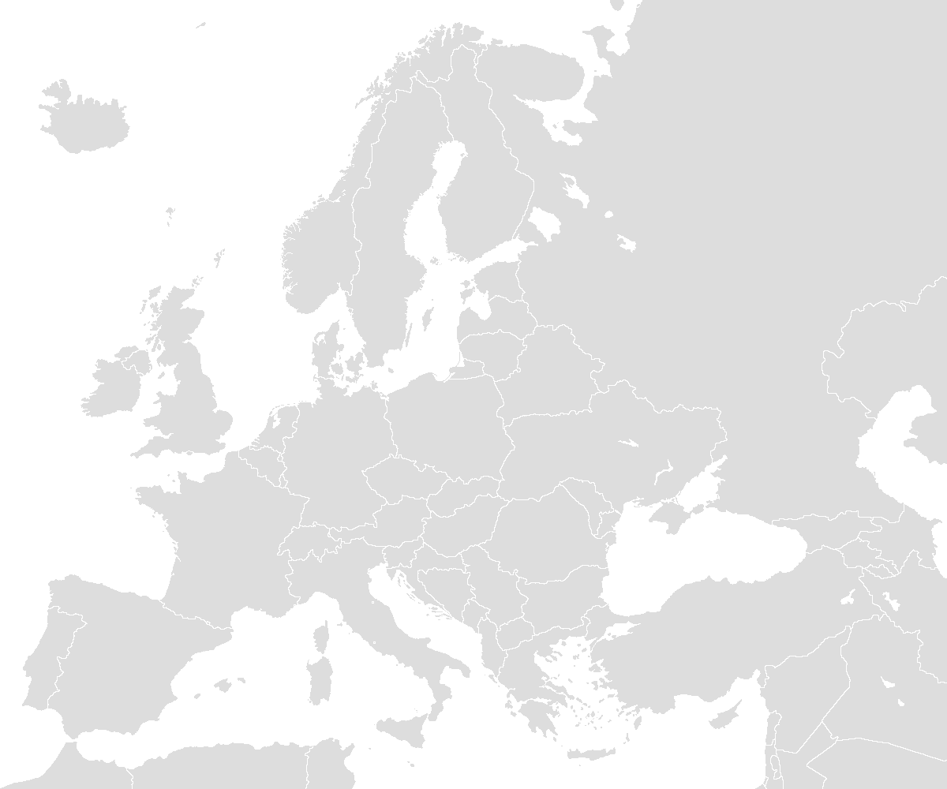

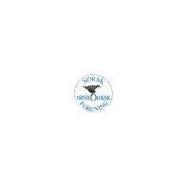
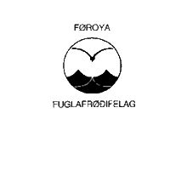

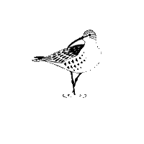






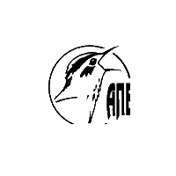

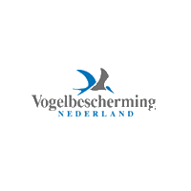



























NGOs in Brussels
David versus Goliath
Umbrellas, supported by national partners
Advocating to EU‘s institutions
Events, briefings, studies
Legal assessments
Good cooperation, i.e. Green 10
Exchange back to national level
Transparency

Slide 55









#NatureAlert

Slide 56

#LivingLand: „Wir haben es satt“ Protests (2017)
Foto: NABU

Slide 57


LivingLand: CAP Public Consultation 2017

Slide 58

LivingLand: 260,000 supporters / 600 logos
Foto: EEB/BirdLife Europe

Slide 59

Building the arguments: Environment
Fitness Check of the CAP

Slide 60
Building the arguments: Sio-Economic
Maintaining Direct Payments based on “Grossly misleading”* Commission (2017) graph
* Prof. Alan Matthews
FRANCE (source: micro-sources) | 1997 € | 2003 € | Annual percentage change 1997–2003 (%)
Per household
Average
Farmers’ households | 32,310 | 29,890 | -1.3
All households | 25,570 | 28,410 | 1.8
Farmers as percentage of all households | 126.4 | 105.2
Median
Farmers | 27,750 | 27,940 | 0.1
All households | 24,230 | 24,230 | 1.7
Farmers as percentage of all households | 126.8 | 115.3
Notes:
Typical picture on farm income (from prof Hill presentation):
Farm households often have other income in addition to that from the farm
Other income adds stability to income from farming (instability an intrinsic problem)
No. of low income case reflect period chosen
Farmers have average total or disposable incomes similar to or above national average (not all MS)
There is a tail of low income cases (poverty)
Points to need for targeted support

Slide 61

Building the arguments: Fairness
80% of direct payments → 20% of beneficiaries
35% of payments → 1.5% beneficiaries
Source: Alan Matthews, 2016
Notes:
Source of graph: http://capreform.eu/focus-on-the-distribution-of-direct-payments/

Slide 62
The post 2020 CAP ‘A Smarter, Modern and Sustainable CAP’?
Key idea:
More flexibility for Member States
Results driven
EU level set objectives
But, inconsistencies:
In denial of environmental problems of farmland
Maintenance of Direct Payments and current structure

Slide 63
Why also this CAP reform will remain an interesting discussion to follow!
Brexit
Sustainable Development Goals and Paris Agreement
European Elections
Larger Public interest
Back to the past market wise?
What do you think is the future for food and farming? The future of Europe? The future of the CAP?

Slide 64
Thank you for your attention!
Trees Robijns Agriculture and Bioenergy policy officer
NABU Charitéstraße 3 10117 Berlin trees.robijns@nabu.de www.NABU.de

